Slide 1
Ukraine C-IED Project
Online Studio 3 Group 3
Valérie Lavigne, valelavi@gmail.com
Marius Panga, marius.c.panga@gmail.com
Jayaram Shivas Vadakumpuram, shivasj@gmail.com

Slide 2
Goals

Slide 3
Tasks

Slide 4
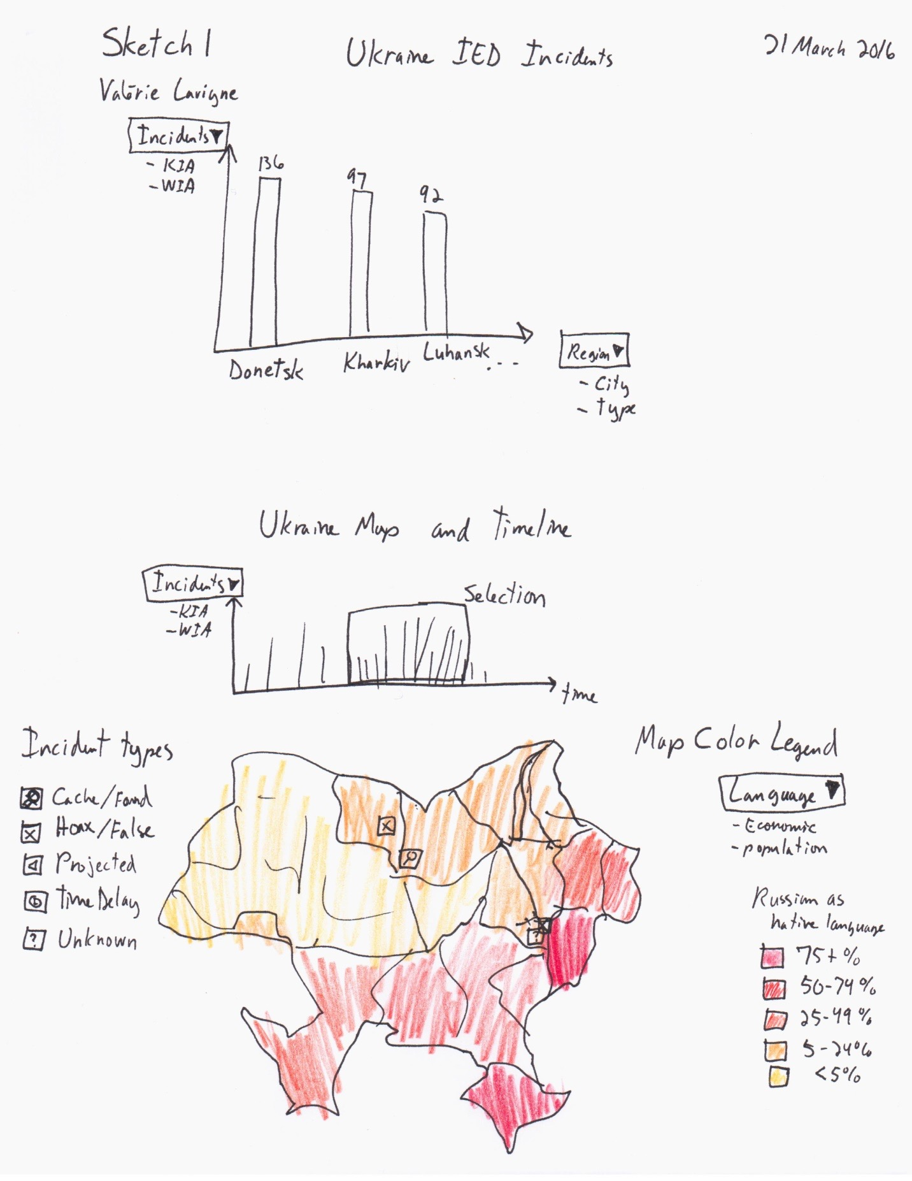
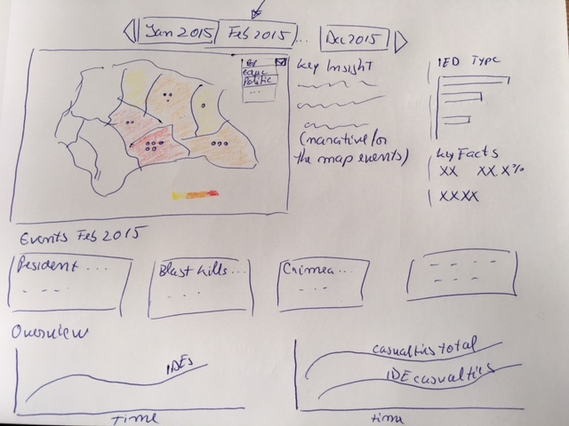
Sketches

Slide 5
Data
DATE | TYPE | KIA | WIA | CITY | REGION | COUNTRY | DETAILS | GROUP | REMARKS
2015 DEC 09 | CACHE/FOUND | 0 | 0 | Kramatorsk | DONETSK | UKRAINE | IEDs were found and disposed by Combat Engineers |  | TBC if they were just landmines
2015 DEC 09 | UNKNOWN | 0 | 0 | Kharkiv | KHARKIV | UKRAINE | An IED was blown up in front of a ROSHEN shop |  | Shopping Center
2015 DEC 08 | UNKNOWN | 0 | 0 | Kiev | KIEV | UKRAINE | A device was detonated against a restaurant (L'Kafa) |  | Boulevard Lesi Ukrainian
2015 DEC 07 | HOAX/FALSE | 0 | 0 | Ivano-Frankivsk | IVANO-FRANKIVSK | UKRAINE | Call reporting IED - First Responders action - no explosive |  | Central Metro/bus station
2015 DEC 02 | CACHE/FOUND | 0 | 0 | Krasnoarmiisk | DONETSK | UKRAINE | An IED was found and disposed by EOD
2015 DEC 02 | CACHE/FOUND | 0 | 0 | Avdeevka | DONETSK | UKRAINE | A cache with 3 IEDs with TNT was found and cleared |  | Inside an abandoned house
2015 DEC 02 | UNKNOWN | 0 | 0 | Uzhgorod | ZAKARPATS'KA | UKRAINE | An IED was detonated against a store in Franko Street

